Slide 1
Blood Drive
Name
Course
Date

Slide 2
Part 1
I had an amazing experience doing a community service, donating blood and caring for the donors, giving them something to eat and drink, as well as making sure they feel well.
I worked with Interact club under (INSERT SUPERVISORS NAME) my supervisor
The donors were so cooperative.
I chose this project because it inspires me to save lives since other people will need it and it does not affect me in any way
Donating blood is also good for keeping healthy
I also did a thanksgiving dinner; feeding the elders after school hours
i had an interesting time with the elders, the jokes and moral stories were fascinating. I would love to keep doing it during my free time.

Slide 3
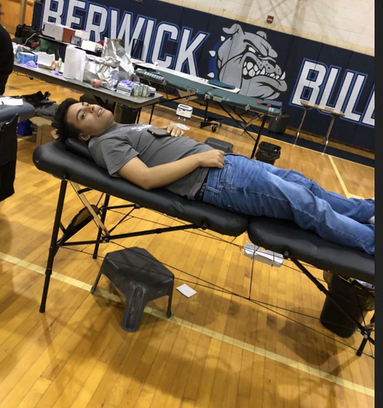
Donating blood at interact club

Slide 4
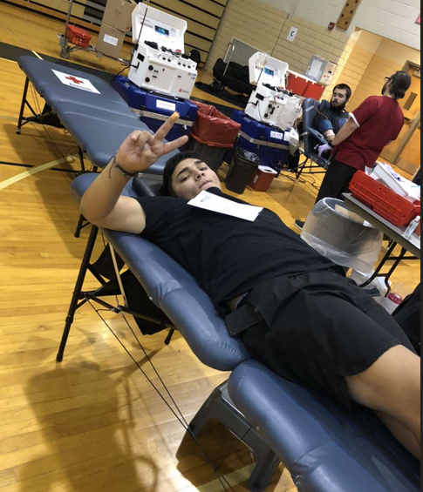
Caring for the donors

Slide 5
Part 2
Personally, I learnt the virtue of giving back to the society
It is worth donating blood as every one time a person donates saves at least 3 lives of people
It is also a healthy exercise to donate blood regularly as it helps the blood flow better, balance iron levels, decrease blood pressure, and reduces risks of heart attacks.
I would recommend friends, relatives and other people to donate blood to save the life of another person.
I would work with interact club again since we share a common purpose of saving lives
The club gives hope to patients in need of blood which is the best thing to do as a voluntary service.

Slide 6
Thank you!

